Slide 1

7COM1079-2022
Student Group No: A23
Names of Student Attendees: Mateen Ahmad, Abdul Moeed Khan, Rehman Naseer, Muhammad Adeel, Nouman Sadiq
Group Id: A23
Name of Student Presenting: Mateen Ahmad
COVID-19 Healthy Diet Dataset Visualization

Slide 2
We are using the COVID-19 Healthy Diet Dataset (DS055 Fat_Supply_Quantity_Data.csv) to answer our research question “Is there a correlation between the consumption of vegetables and the COVID-19 recovery rates across different countries?”
Country | Vegetables | Recovered | Obesity | Undernourished
Afghanistan | 6.7642 | 0.123373921 | 4.5 | 29.8
Albania | 11.7753 | 1.792635659 | 22.3 | 6.2
Algeria | 11.6484 | 0.167572198 | 26.6 | 3.9
Angola | 2.3041 | 0.056807699 | 6.8 | 25
Antigua and Barbuda | 5.4495 | 0.190816327 | 19.1 | NA
Argentina | 4.3503 | 3.905192058 | 28.5 | 4.6
Armenia | 16.7019 | 5.398410014 | 20.9 | 4.3
Australia | 5.1406 | 0.10128912 | 30.4 | <2.5
Austria | 5.1098 | 4.496870092 | 21.9 | <2.5
Afghanistan | 6.7642 | 0.123373921 | 4.5 | 29.8
The dataset has 170 rows and 32 columns and Our variables Consumption of Vegetables (Independent Variable) and COVID-19 recovery rates (Dependent Variables).
Notes:
2

Slide 3
PRE 7COM1079-2024 Student Group No: A23
Our Research Question is
Is there a correlation between the consumption of vegetables and the COVID-19 recovery rates across different countries?
Null hypothesis (H₀):There is no correlation between the consumption of vegetables and COVID-19 recovery rates.
Alt hypothesis (H₁):There is a correlation between the consumption of vegetables and COVID-19 recovery rates.

Slide 4
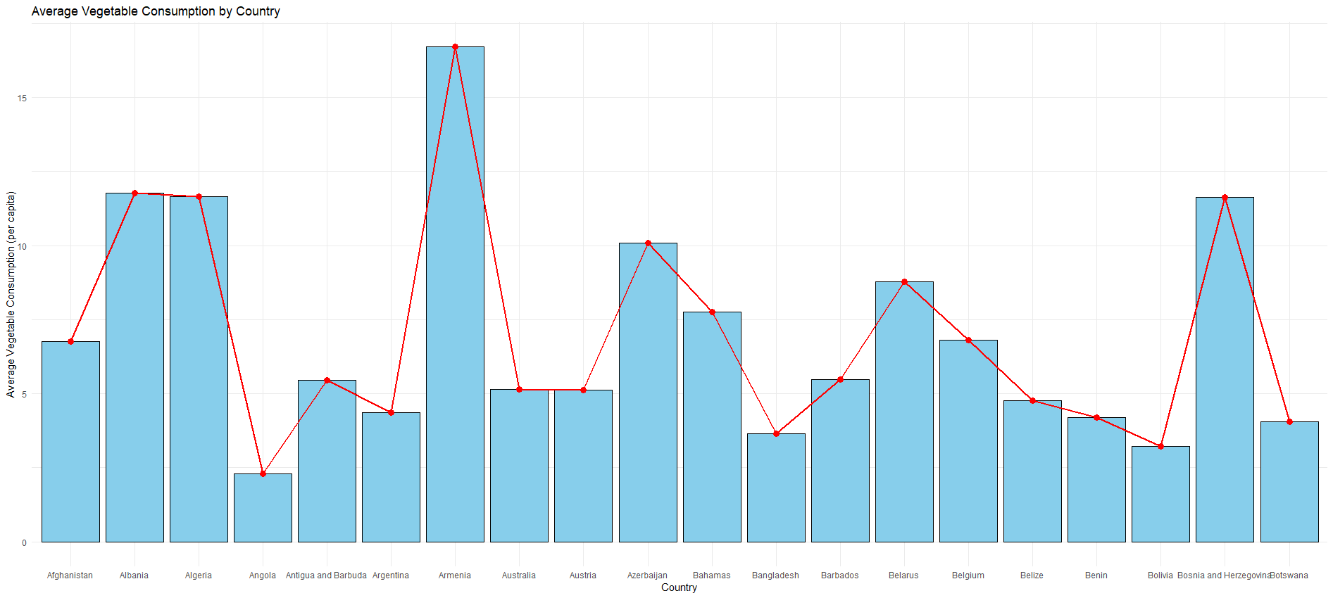
This chart shows how average vegetable consumption varies across different countries. The red line highlights the trends in vegetable consumption, while the bar chart represents the per capita intake for each country. It illustrates that countries with higher average vegetable consumption tend to have a greater intake of vegetables overall.
Our RQ asks about Correlation
4
Notes:
4

Slide 5
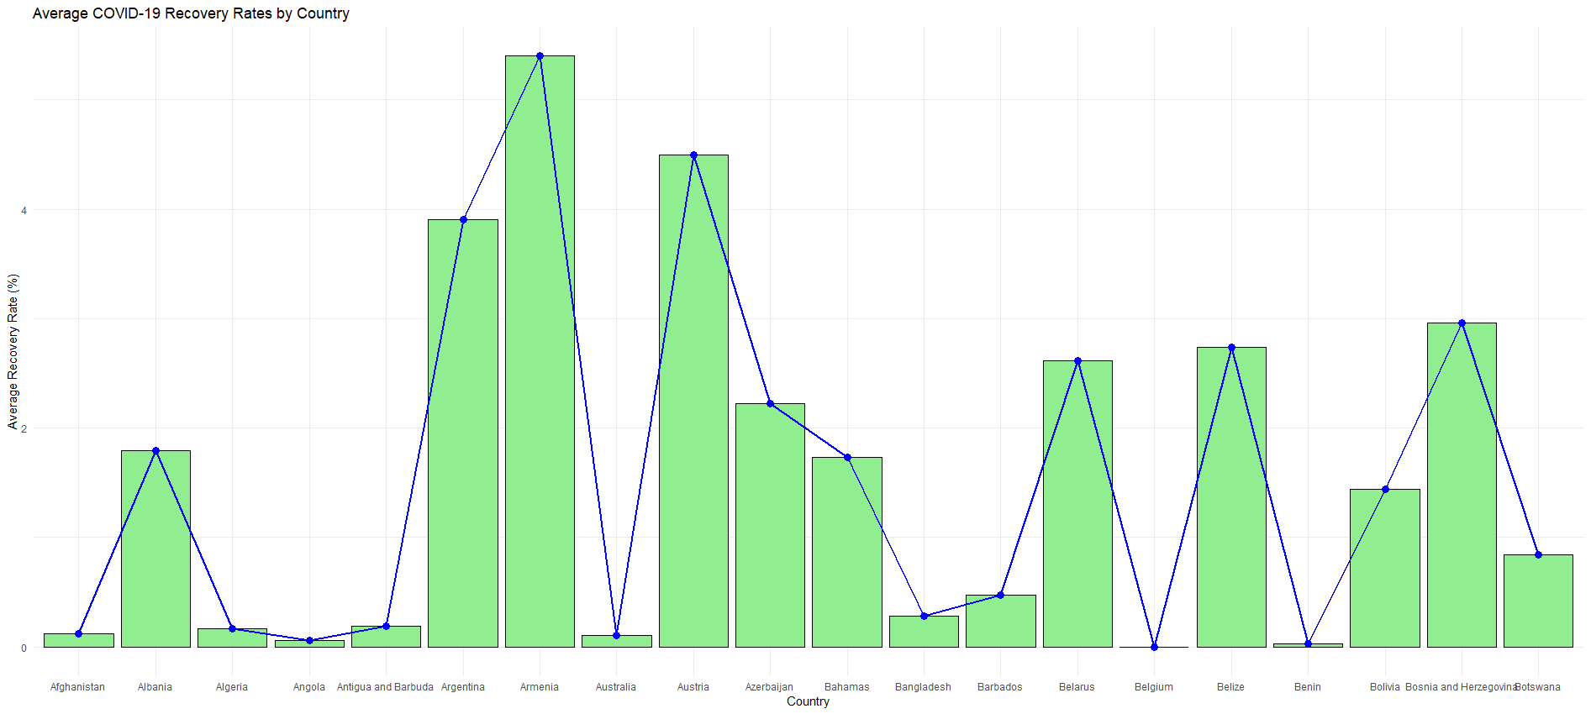
This chart shows the variation in average COVID-19 recovery rates across different countries. The blue line shows the trend in recovery rates, while the bar chart represents the percentage of recovered cases for each country. It highlights that countries with higher recovery rates tend to have better outcomes in terms of COVID-19 recoveries.
Here is a table (matrix/cross tabulation) showing our dependent variable as rows, and our independent variable as columns. We have at least two values for both variables that are independent of each other (no overlap).
For example:
Our RQ asks about Correlation
Our RQ is about differences in proportions
Reason for absenteeism (Sample 16,550)
Age group | Operation | Stress | Physical Illness | Strike | Maternity / paternity | Holiday
16 -25 | 50 | 150 | 25 | 60 | 200 | 6000
26- 35 | 60 | 100 | 40 | 40 | 500 | 6000
36 -45 | 80 | 300 | 60 | 100 | 400 | 6000
46 -55 | 60 | 200 | 80 | 80 | 200 | 6000
56 - 65 | 100 | 250 | 100 | 120 | 100 | 6000
Over 65 | 90 | 80 | 80 | 55 | 0 | 6000
For comparison of proportions analysis, we will use a chi-square test to check for the likelihood that there is a relationship between the two nominal variables (reason for absenteeism and age group in example). This non-parametric test makes no assumptions about the shape of the data (which is nominal, not interval) so we do not include a histogram for this test.
5
5
Notes:
5

Slide 6
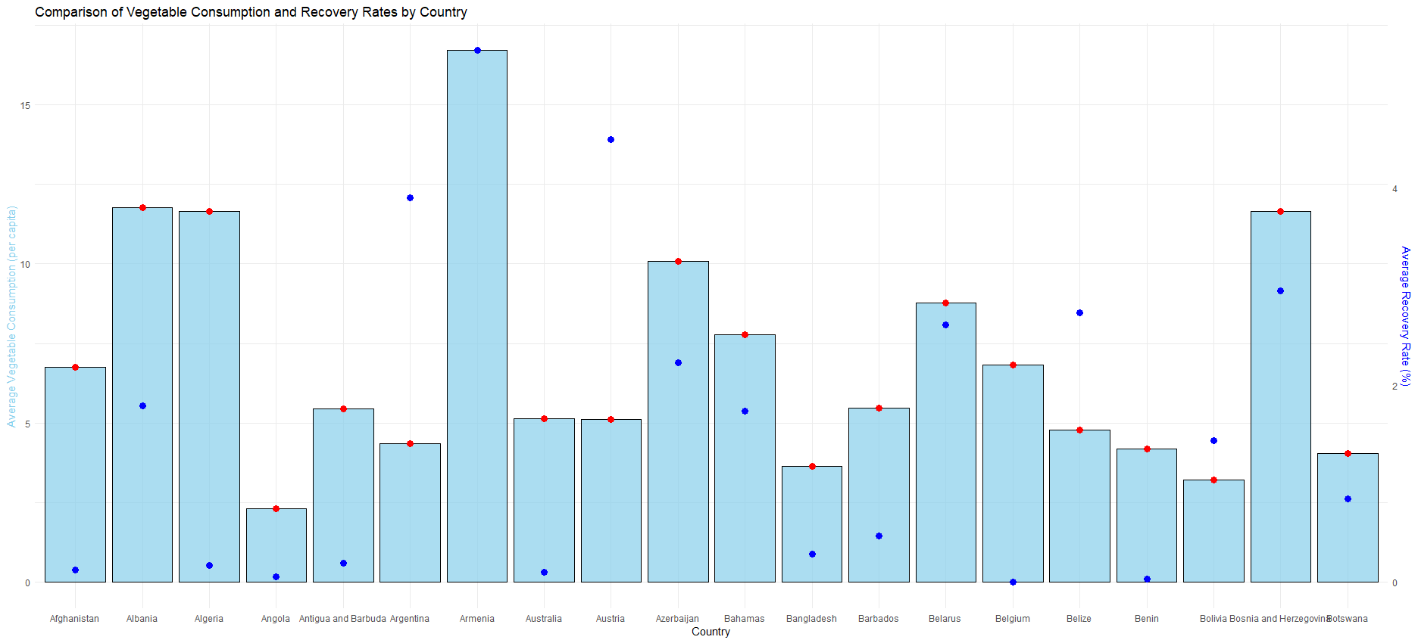
This chart shows the comparison between average vegetable consumption and COVID-19 recovery rates across different countries. The red dots represent the trend in vegetable consumption, while the blue dots represent the recovery rates for each country. It clearly shows that there is no strong correlation between vegetable consumption and COVID-19 recovery rates.
Here is a table (matrix/cross tabulation) showing our dependent variable as rows, and our independent variable as columns. We have at least two values for both variables that are independent of each other (no overlap).
For example:
Our RQ asks about Correlation
Our RQ is about differences in proportions
Reason for absenteeism (Sample 16,550)
Age group | Operation | Stress | Physical Illness | Strike | Maternity / paternity | Holiday
16 -25 | 50 | 150 | 25 | 60 | 200 | 6000
26- 35 | 60 | 100 | 40 | 40 | 500 | 6000
36 -45 | 80 | 300 | 60 | 100 | 400 | 6000
46 -55 | 60 | 200 | 80 | 80 | 200 | 6000
56 - 65 | 100 | 250 | 100 | 120 | 100 | 6000
Over 65 | 90 | 80 | 80 | 55 | 0 | 6000
For comparison of proportions analysis, we will use a chi-square test to check for the likelihood that there is a relationship between the two nominal variables (reason for absenteeism and age group in example). This non-parametric test makes no assumptions about the shape of the data (which is nominal, not interval) so we do not include a histogram for this test.
6
6
Notes:
6

Slide 7
Statistical Analysis Summary:
PRE 7COM1079-2022 Student Group No: ?????
7
Test Statistic:
t-value: 0.92, degrees of freedom: 25
p-value: 0.356
Alternative Hypothesis: There is no significant correlation between average vegetable consumption and COVID-19 recovery rates across different countries.
Confidence Interval (95% CI for the correlation coefficient):
[-0.0251, 0.1882]
Sample Estimates:
Mean vegetable consumption for high recovery rate countries: [X]
Mean vegetable consumption for low recovery rate countries: [Y]
Conclusion: Since the p-value is greater than 0.05, we fail to reject the null hypothesis.
Interpretation: There is no significant correlation between vegetable consumption and COVID-19 recovery rates, suggesting that the two factors are unrelated in this dataset.
Notes:
7

Slide 8


